Slide 1

Three Difference Structure of Slides Speaker: Po-Chuan Chen Date: Oct. 5 2023

Slide 2

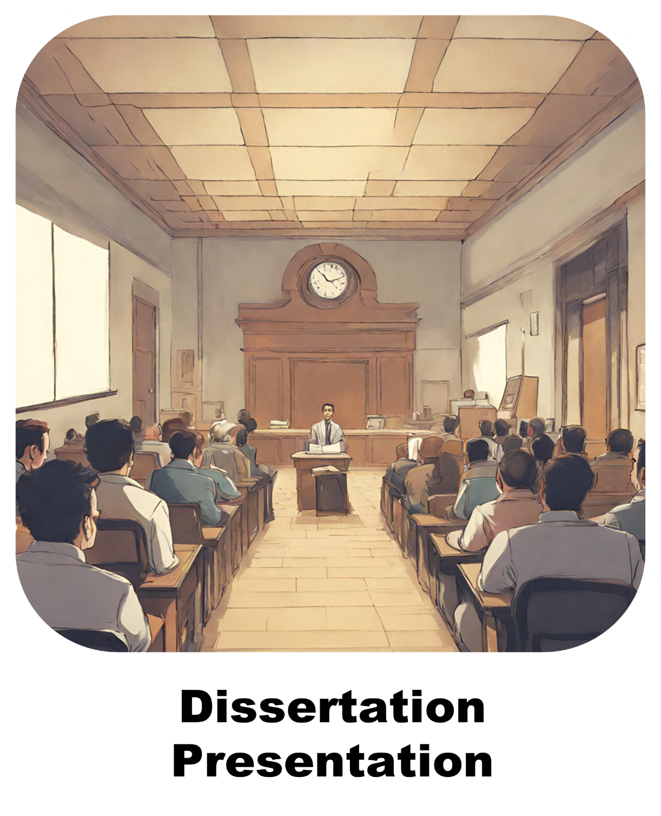

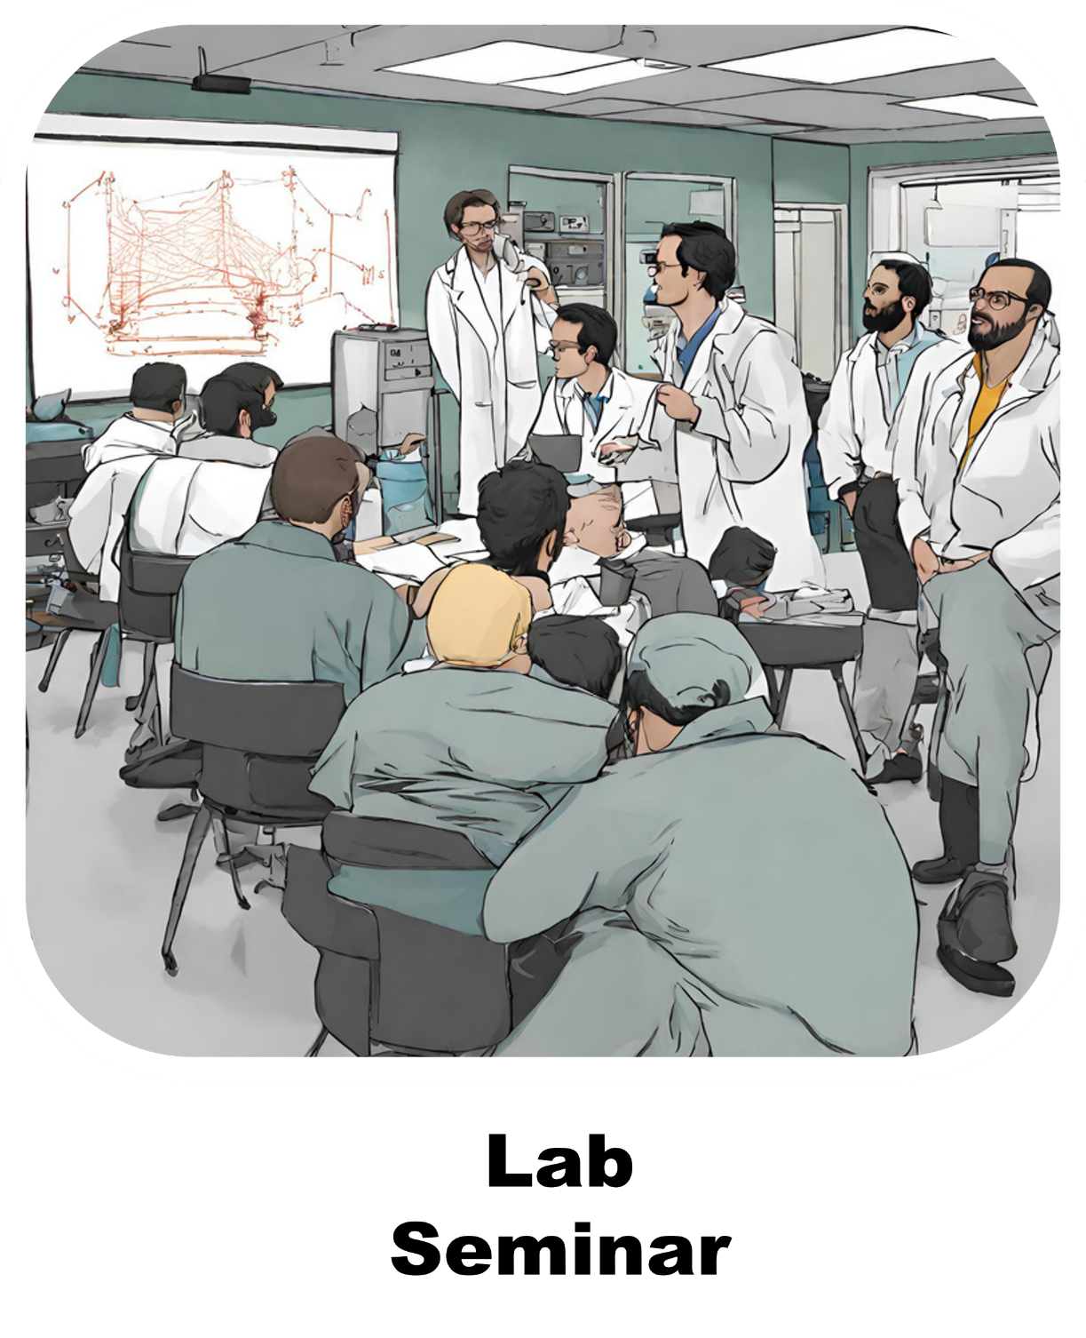

Slide 3
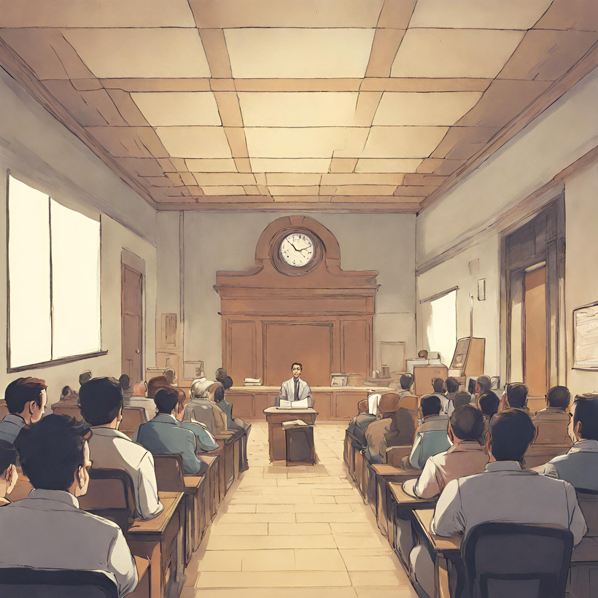
Dissertation Presentation

Slide 4
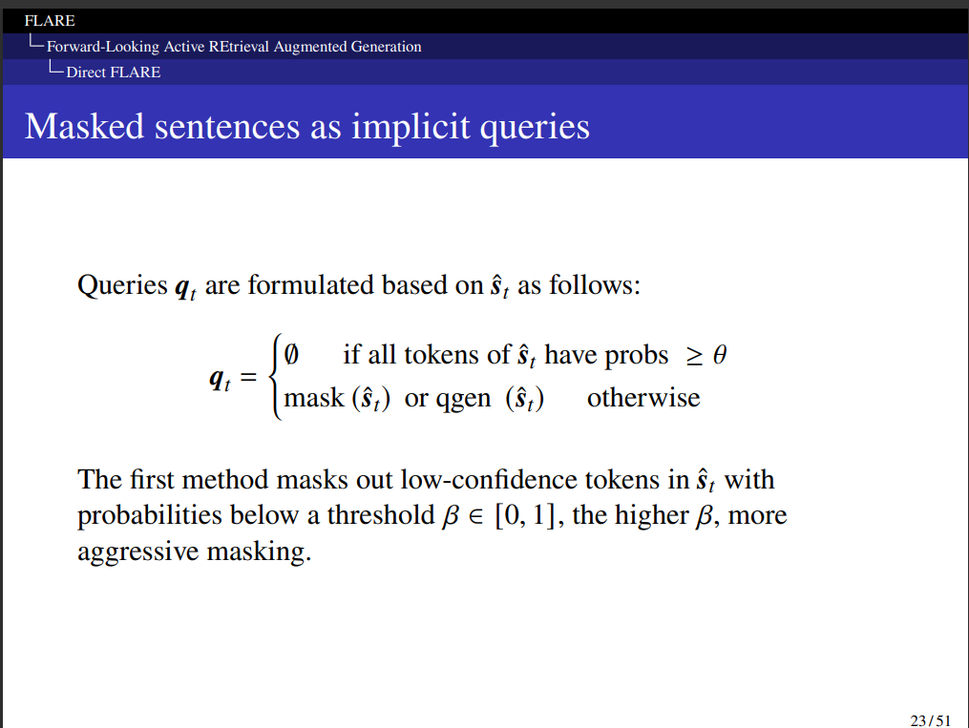
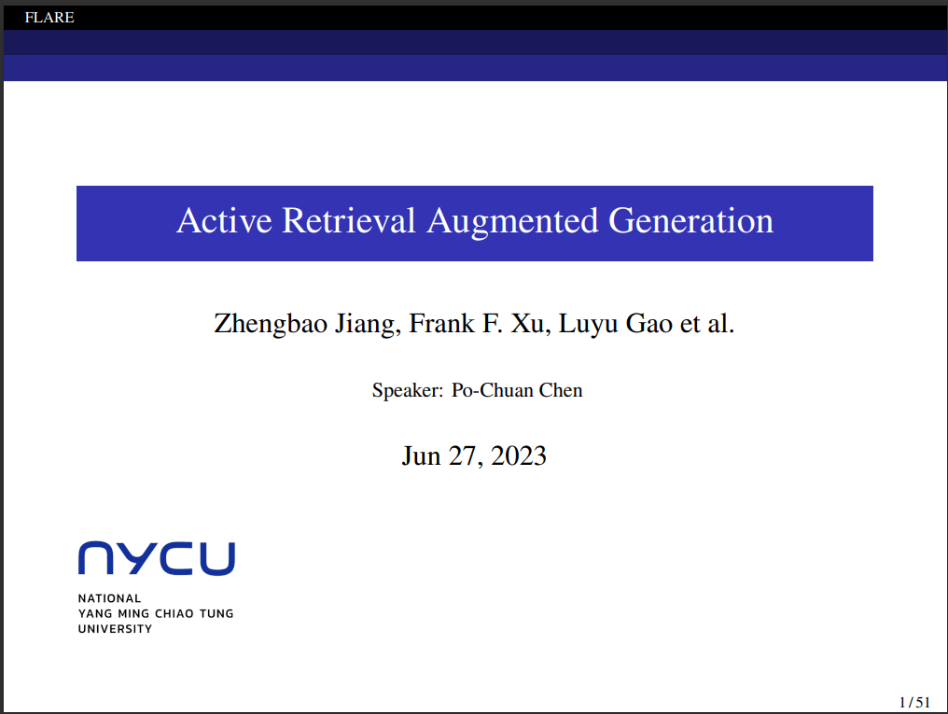
Dissertation Presentation
Simple color and word format
Needs LaTeX
Describing the research content in detail

Slide 5
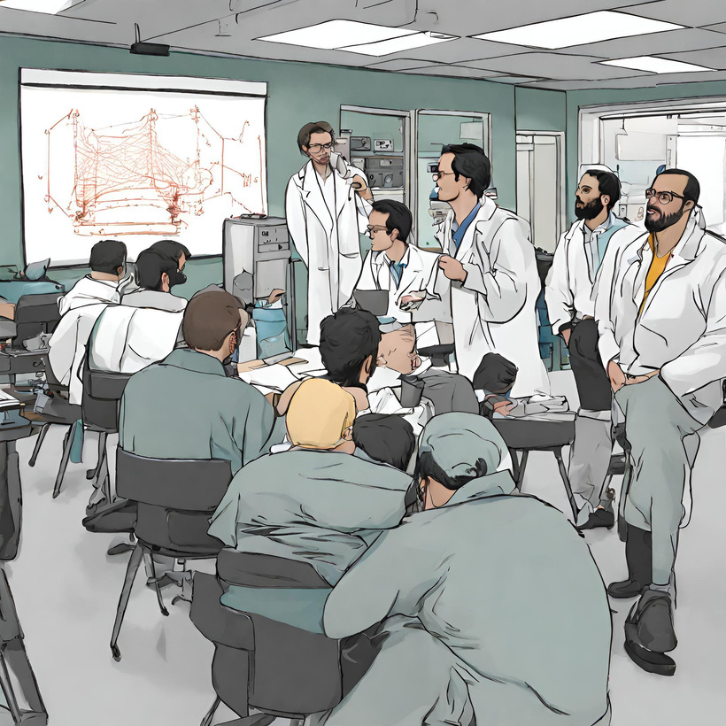
Lab Seminar

Slide 6

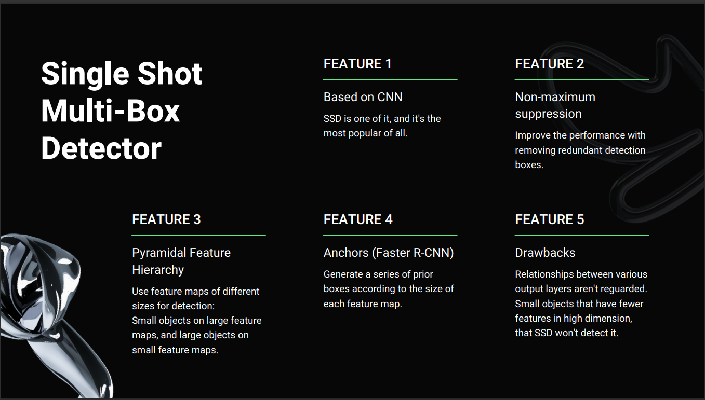
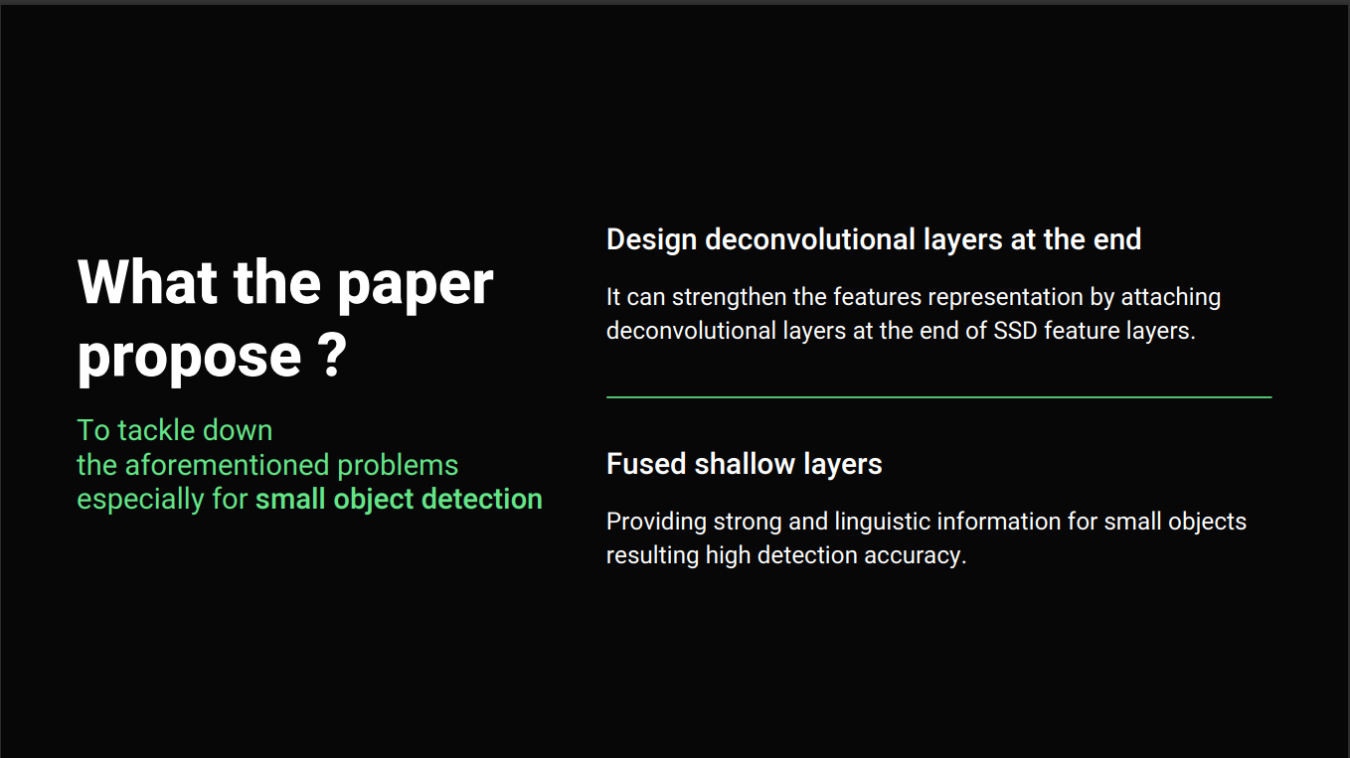

Lab Seminar
More text style and color options
But, in our lab, we need to prepare lab seminars similar with Dissertation Presentation
Share ideas and make your audience think
Analyzing and expressing simply and concisely

Slide 7

A Talk to Junior

Slide 8

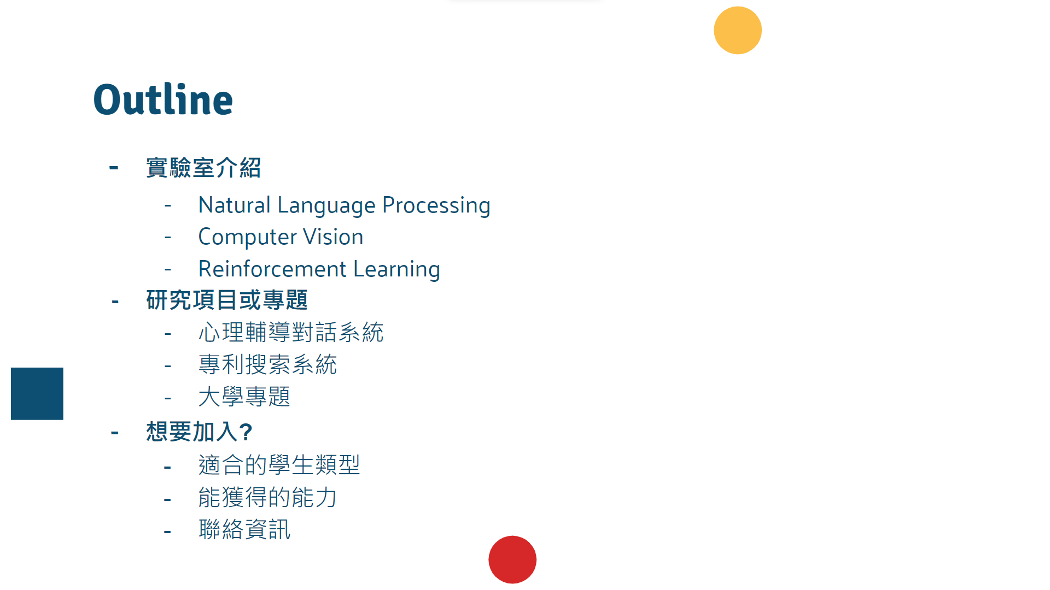
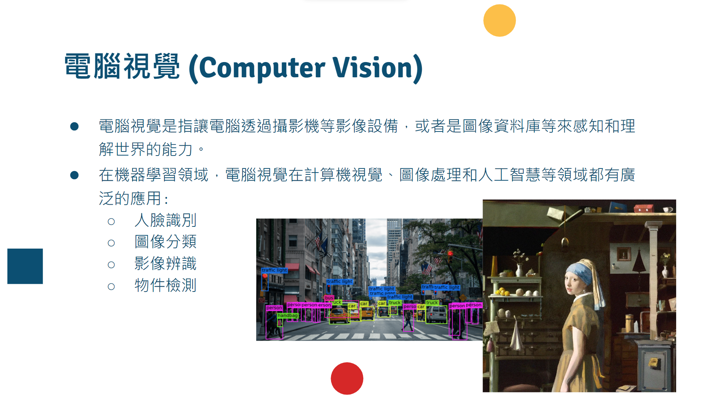
A talk with junior
Big picture
Content needs to be interesting and engaging
Easy understanding

Slide 9



What’s Difference ?
Defending the research findings and demonstrate the expertise in the field of study.
Sharing research progress, findings, and ideas with colleagues within the lab.
Providing an informative and engaging overview of the lab's research and potentially attract new members or collaborators.

